Slide 1
Digital Image Processing
Lecture # 2: Fundamentals

Slide 2
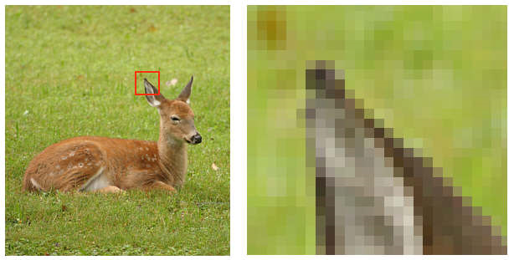
Digital Image
a grid of squares, each of which contains a single color
1 pixel
each square is called a pixel (for picture element)
2
Notes:
2

Slide 3
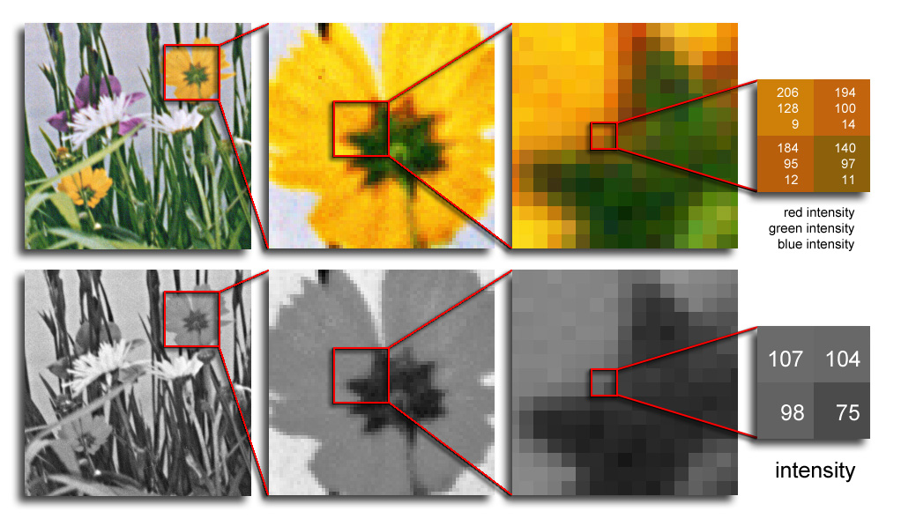
Digital Image
Color images have 3 values per pixel; monochrome images have 1 value per pixel.
a grid of squares, each of which contains a single color
each square is called a pixel (for picture element)
3
Notes:
3

Slide 4
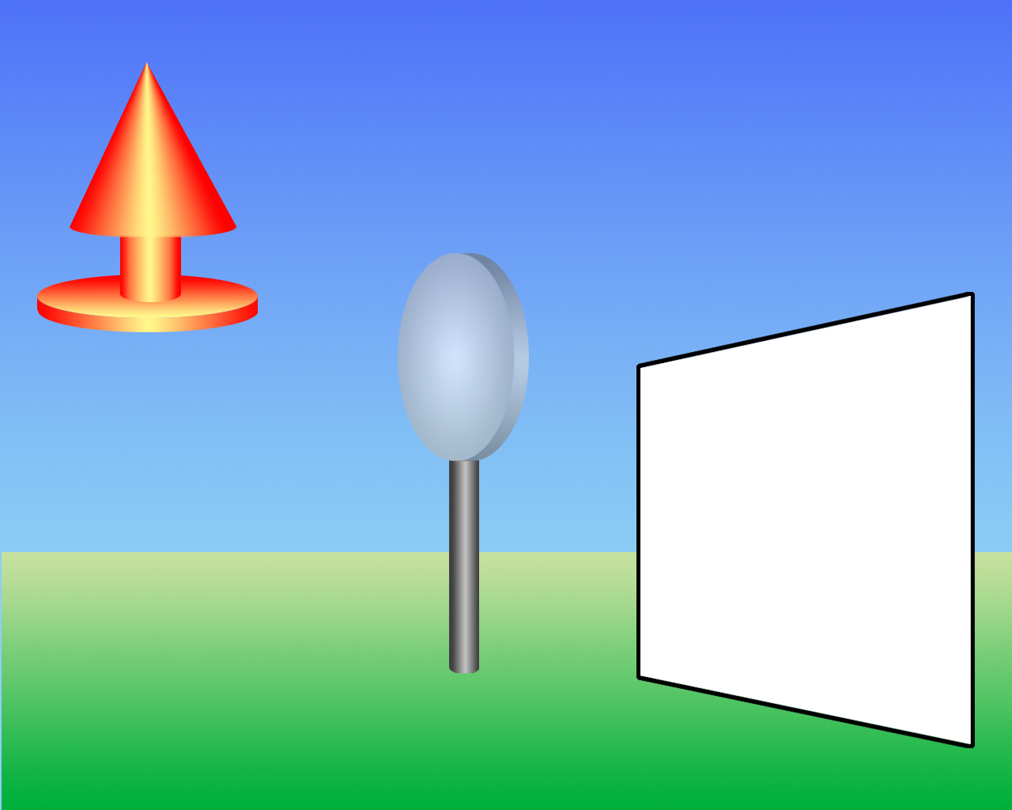
Image Formation
lens
object
image plane
4
Notes:
4

Slide 5
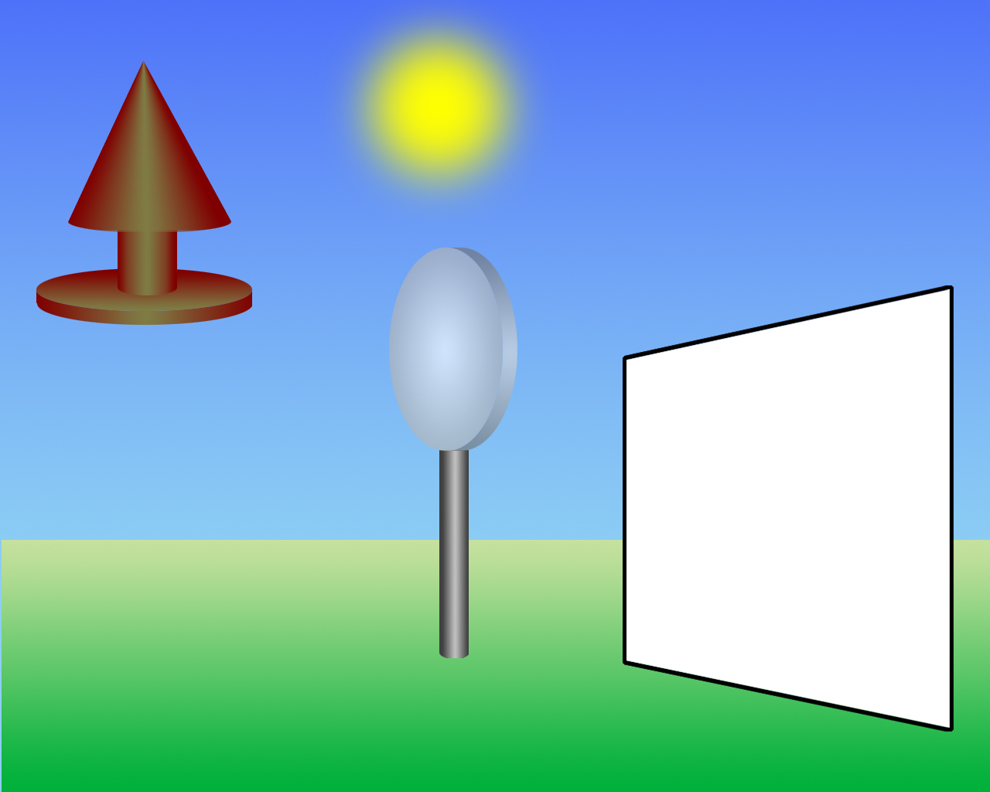
Image Formation
light source
5
Notes:
5

Slide 6
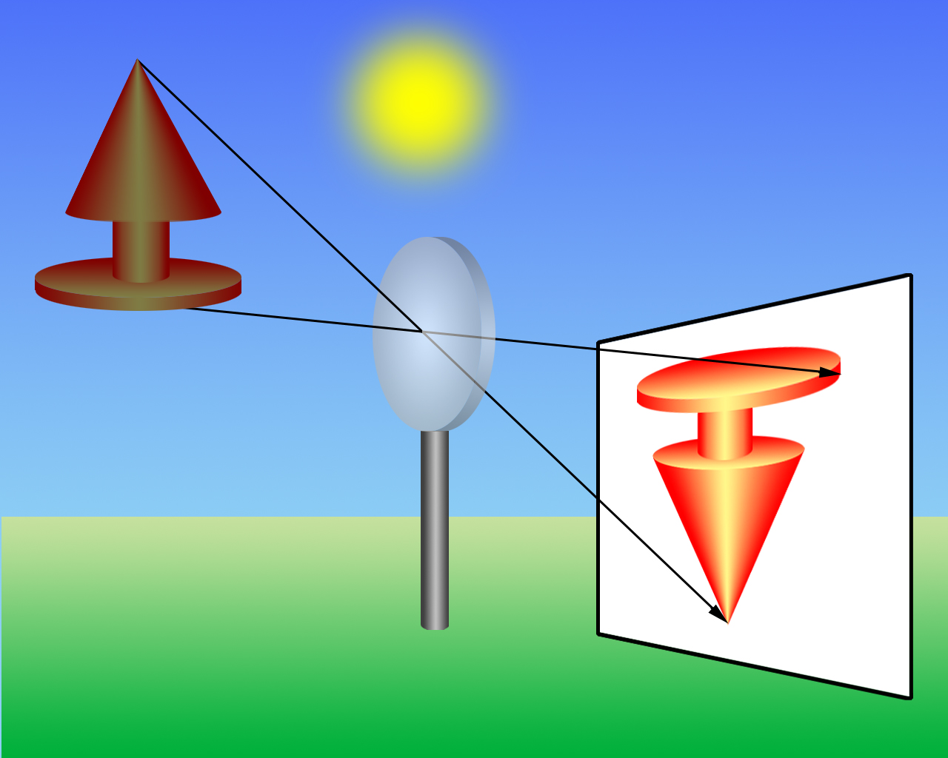
Image Formation
projection
through lens
image of object
6
Notes:
6

Slide 7
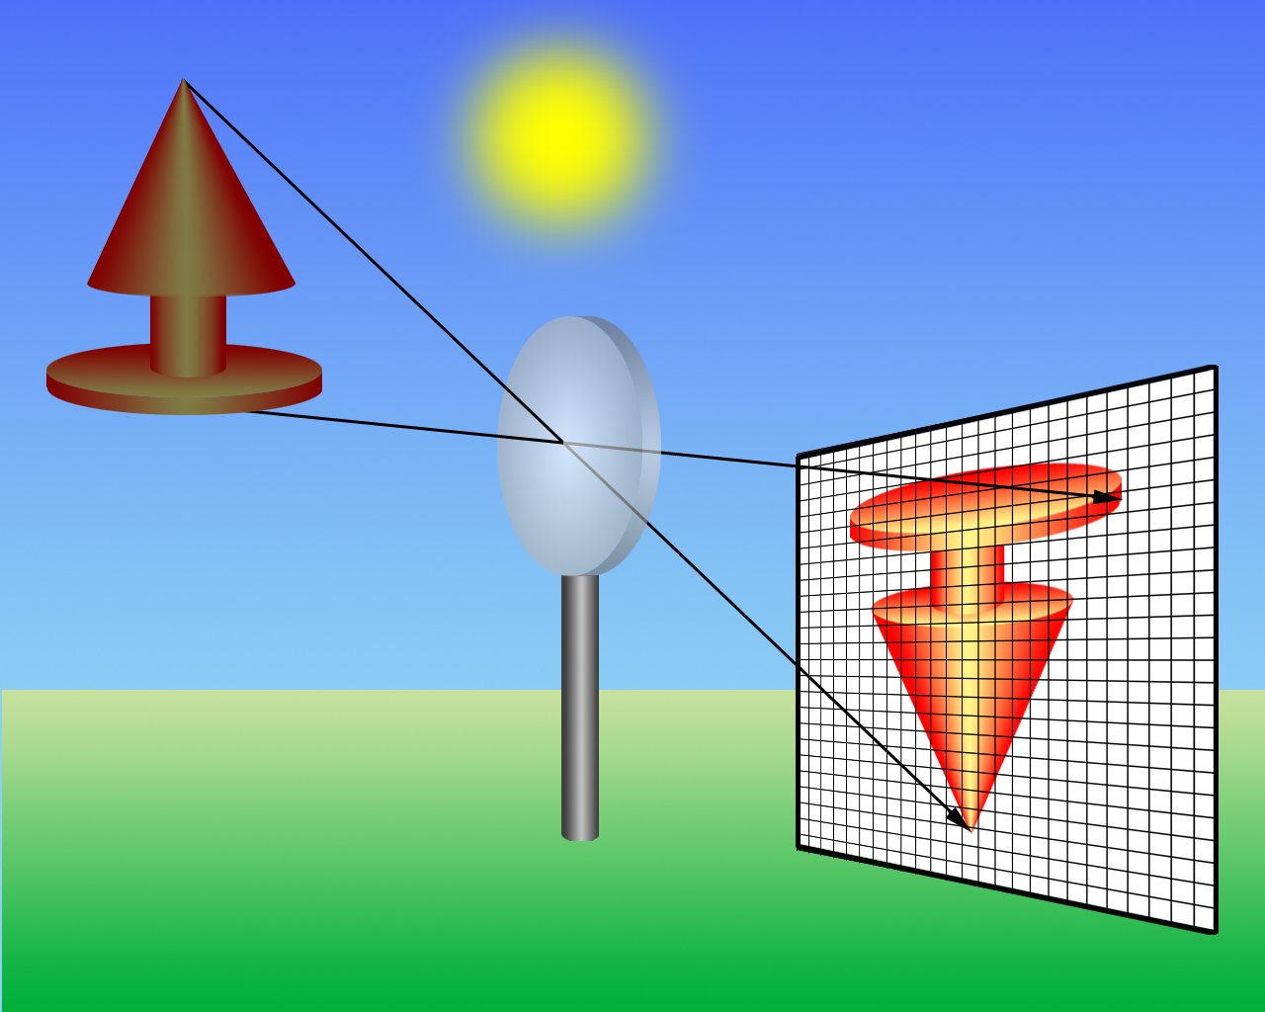
Image Formation
projection onto discrete sensor array
digital camera
7
Notes:
7

Slide 8


Image Formation
Digital Image is an approximation of a real world scene
Sampling
8
Notes:
8

Slide 9

Image Formation
sensors register average color
sampled image
9
Notes:
9

Slide 10


Image Formation
Digital Image is an approximation of a real world scene
Quantization
10
Notes:
10

Slide 11

Image Formation
11
Notes:
11

Slide 12


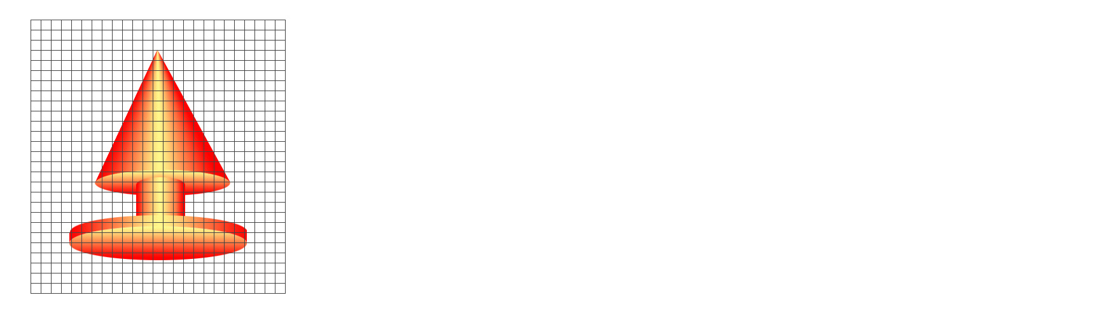
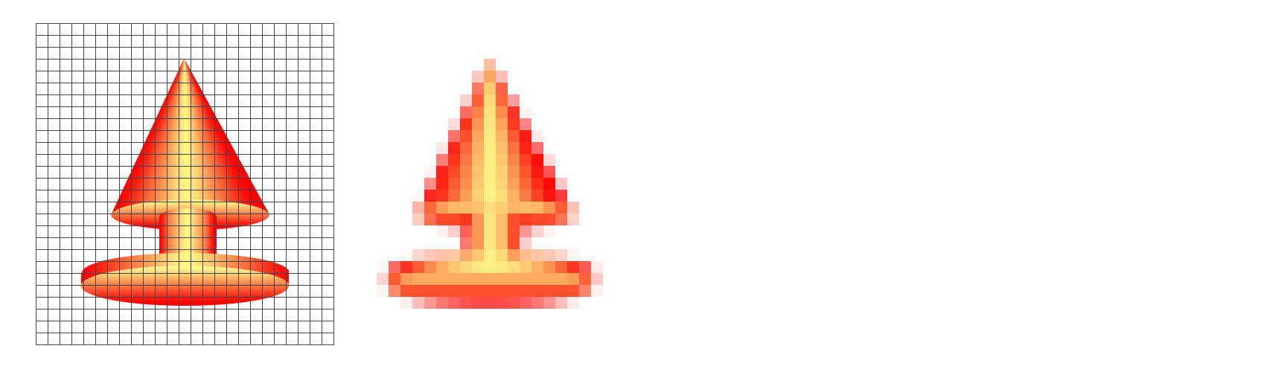
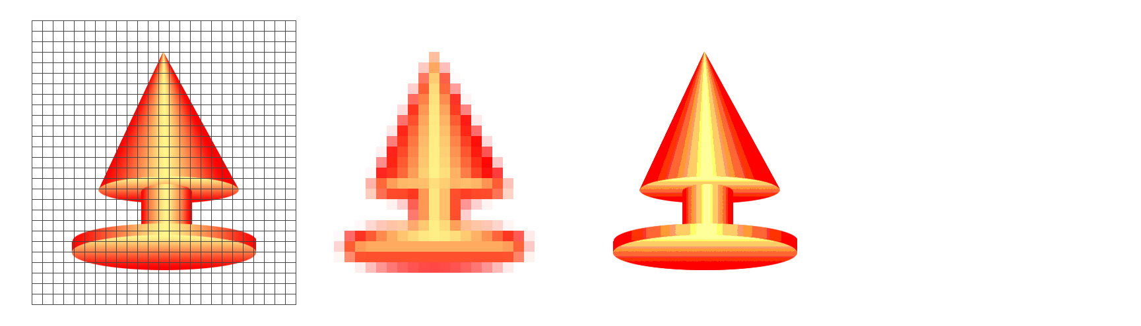
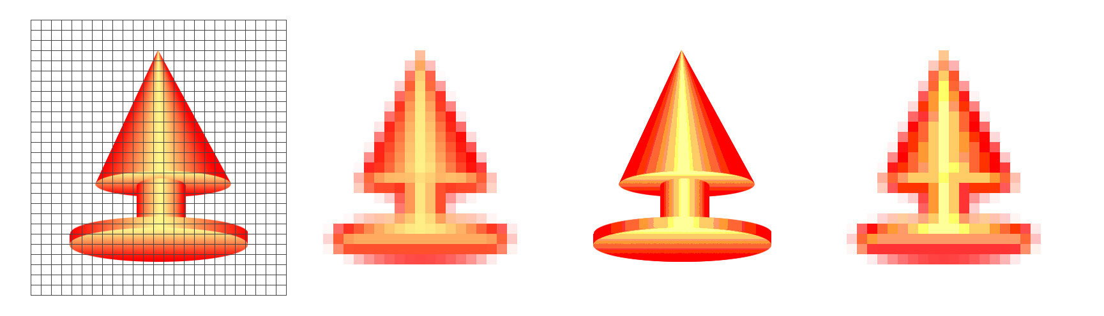
Sampling and Quantization
pixel grid
real image
sampled
quantized
sampled & quantized
12
Notes:
12

Slide 13

Quantization: Example
For Rs. 2 | Return 5
For Rs. 7 | Return 5
For Rs. 9 | Return 10
For Rs. 12 | Return 10
For Rs. 23 | Return 25
…. | ….
Change you return
Actual change

Slide 14

Image Formation - Quantization
continuous colors mapped to a finite, discrete set of colors.
discrete color output
continuous color input
14
Notes:
14

Slide 15
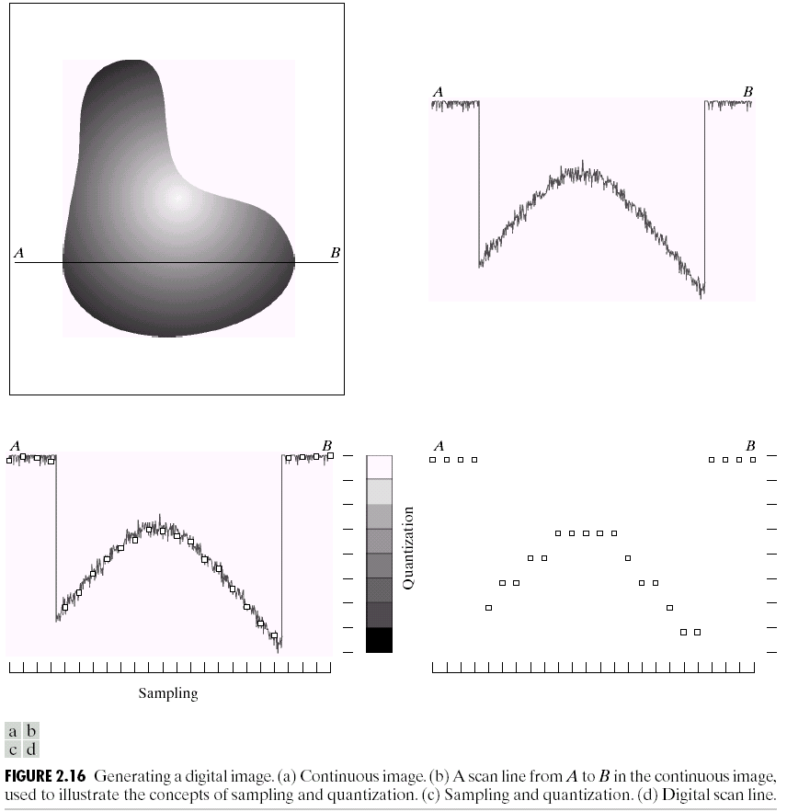
Sampling and Quantization
15
Notes:
15

Slide 16
Sampling and Quantization
16
Notes:
16

Slide 17
Sampling and Quantization
17
Notes:
17

Slide 18
Sampling and Quantization
Digital Image is an approximation of a real world scene
18
Notes:
18

Slide 19
Sampling and Quantization
Sampling:
Digitization of the spatial coordinates (x,y)
Quantization:
Digitization in amplitude (also known as gray level quantization)
19
Notes:
19

Slide 20
Sampling and Quantization
Quantization
8 bit quantization: 2⁸ =256 gray levels (0: black, 255: white)
1 bit quantization: 2 gray levels (0: black, 1: white) – binary
Sampling
Commonly used number of samples (resolution)
Digital still cameras: 640x480, 1024x1024, up to 4064 x 2704
Digital video cameras: 640x480 at 30 frames/second (fps)
20
Notes:
20

Slide 21
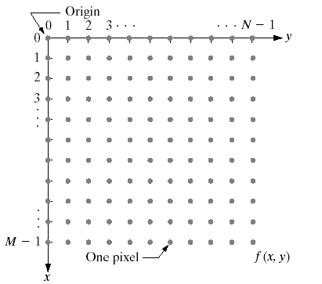
Digital Image Representation
21
Notes:
21

Slide 22
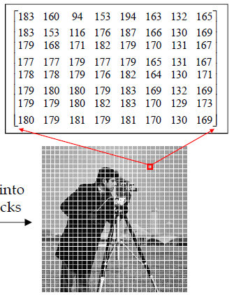
Digital Image Representation
Divided into 8x8 blocks
22
Notes:
22

Slide 23
Digital Image Representation
Number of intensity levels – An integer power of 2
Intensity levels
Dynamic range – Range of values spanned by the gray scale
23
Notes:
23

Slide 24
Digital Image Representation
Image Size
Number of bits required to store an image
Image having 2^{k} intensity levels
k – bit image
256 intensity levels – 8 bit image
24
Notes:
24

Slide 25

Spatial Resolution
The spatial resolution of an image is determined by how sampling was carried out
Three measures we come across when talking about Image Size/Resolution
Pixel count - e.g 3000x2000 pixels
Physical size - e.g. 8" x 10"
Resolution - e.g. 240 pixels per inch (PPI)
Difference/Relation
Between these three?
25
Notes:
25

Slide 26
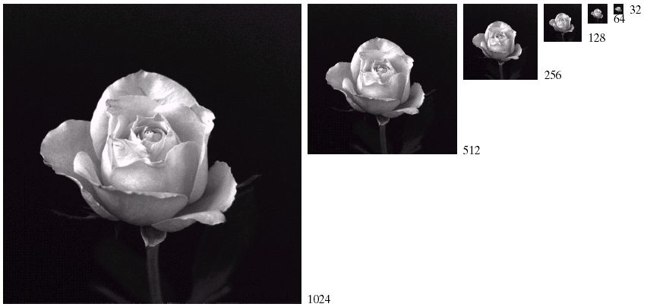
Spatial Resolution
26
Notes:
26

Slide 27
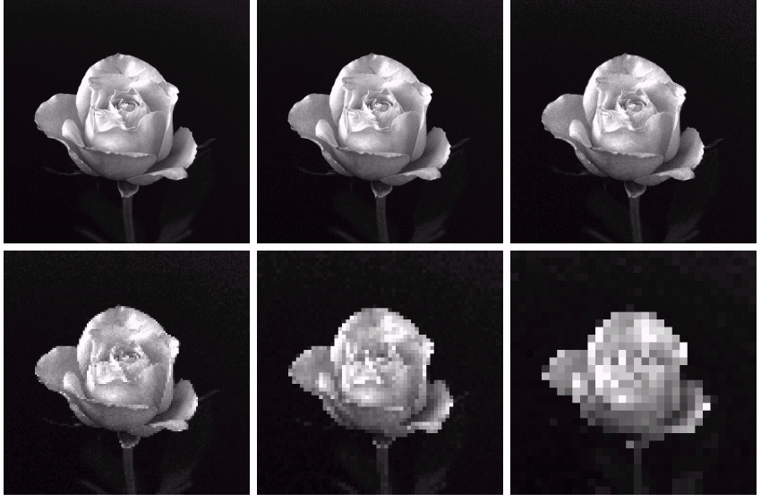
Spatial Resolution
27
Notes:
27

Slide 28
Intensity Level Resolution
Intensity level resolution refers to the number of intensity levels used to represent the image
The more intensity levels used, the finer the level of detail in an image
Intensity level resolution is usually given in terms of the number of bits used to store each intensity level
28
Notes:
28

Slide 29
Intensity Level Resolution
Number of Bits
Number of Intensity Levels
Examples
1
2
0, 1
2
4
00, 01, 10, 11
4
16
0000, 0101, 1111
8
256
00110011, 01010101
16
65,536
1010101010101010
29
Notes:
29

Slide 30
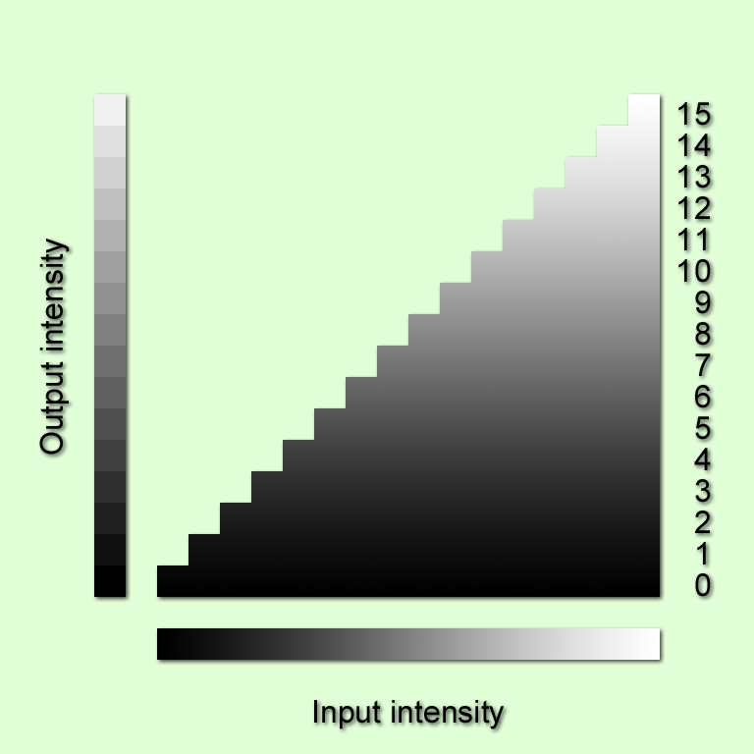


Intensity Level Resolution
16 million colors
16 colors
30
Notes:
30

Slide 31
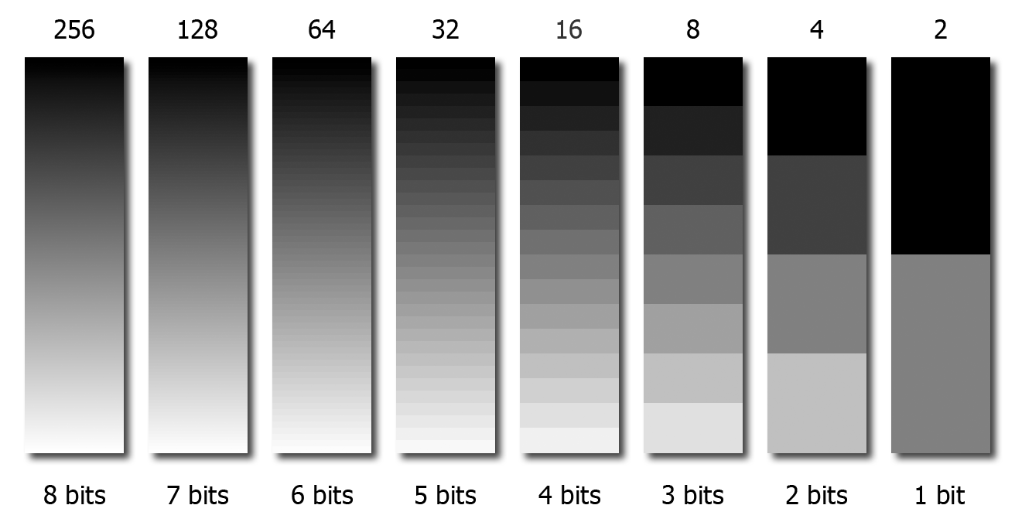
Intensity Level Resolution
31
Notes:
31

Slide 32
Intensity Level Resolution
With 1-bit quantization, the output intensities are taken to be {0,255}.
32
Notes:
32

Slide 33
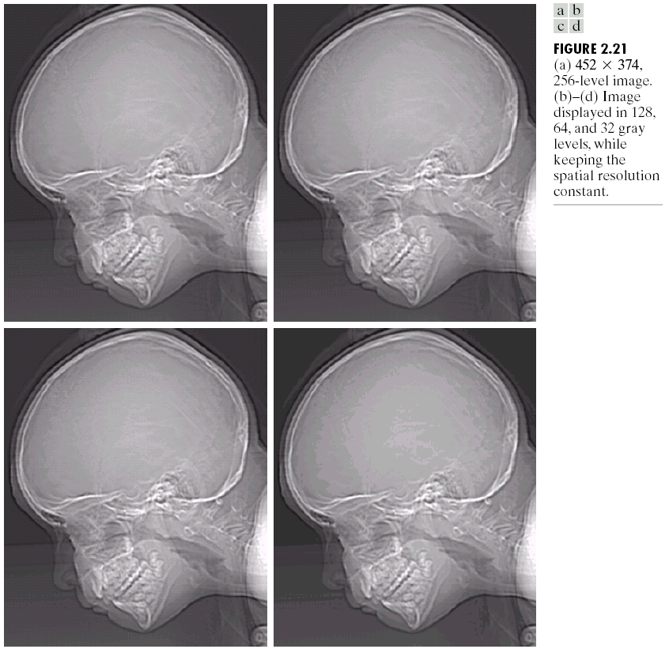
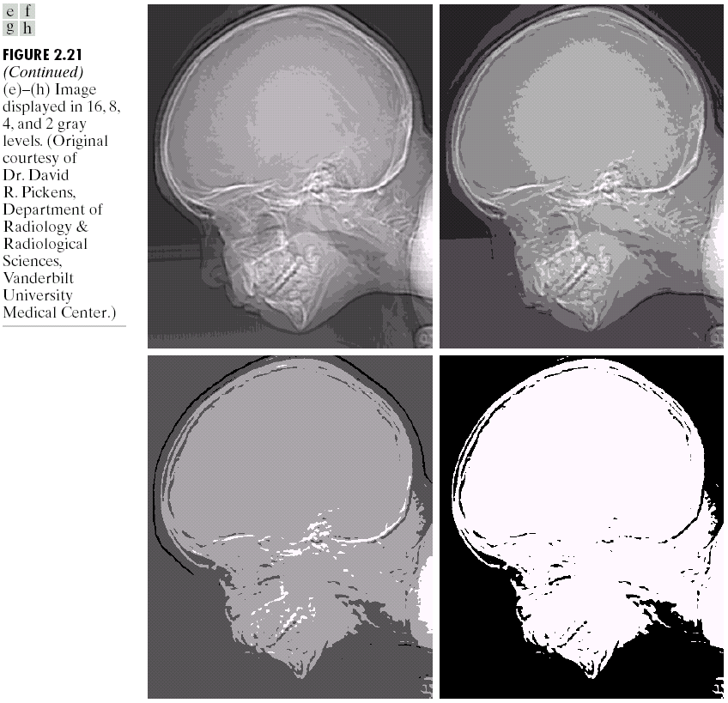
Intensity Level Resolution
256 grey levels (8 bits per pixel)
128 grey levels (7 bpp)
64 grey levels (6 bpp)
32 grey levels (5 bpp)
16 grey levels (4 bpp)
8 grey levels (3 bpp)
4 grey levels (2 bpp)
2 grey levels (1 bpp)
33
Notes:
33

Slide 34







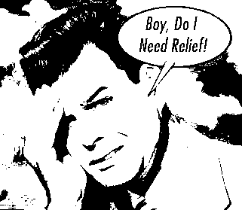
Intensity Level Resolution
8 bits 256 levels
7 bits 128 levels
6 bits 64 levels
5 bits 32 levels
4 bits 16 levels
3 bits 8 levels
2 bits 4 levels
1 bit 2 levels
34
Notes:
34

Slide 35
Resolution: How much is enough?
How many samples and gray levels are required for a good approximation?
Quality of an image depends on number of pixels and gray-level number
The more these parameters are increased, the closer the digitized array approximates the original image
But: Storage & processing requirements increase rapidly as a function of N, M, and k
35
Notes:
35

Slide 36
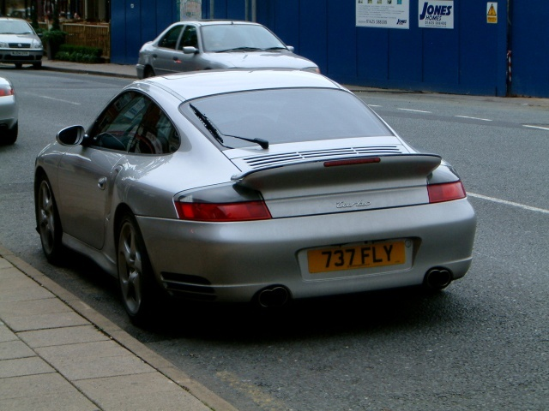

Resolution: How much is enough?
Depends on what is in the image and what you would like to do with it
The picture on the right is fine for counting the number of cars, but not for reading the number plate
36
Notes:
36

Slide 37





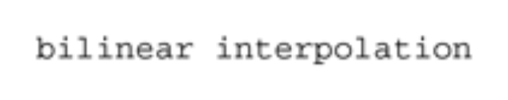

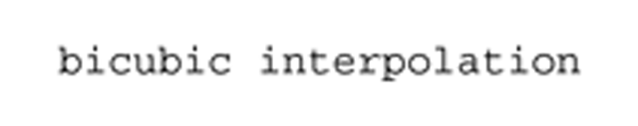

Image Interpolation
Image resizing
Three methods
37
Notes:
37

Slide 38
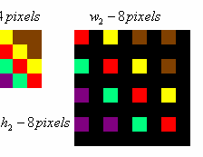
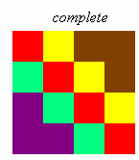
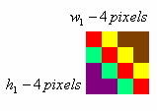
Enlarging an Image
Pixel replication
[1 2 3 4 5]
[1 1 2 2 3 3 4 4 5 5] (One step)
[1 1 1 2 2 2 3 3 3 4 4 4 5 5 5] (Two step)
38
Notes:
38

Slide 39


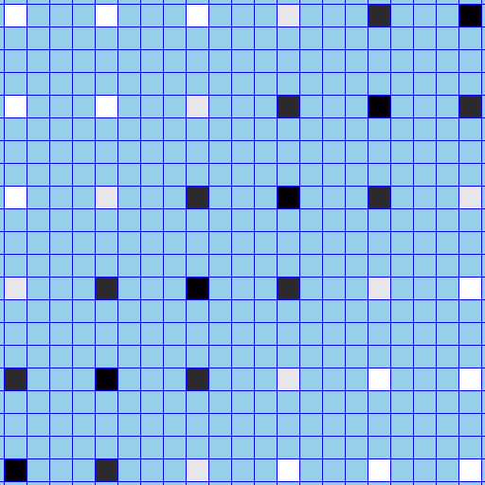

Enlarging an Image
…
…
Example:
zoom this image 4x to get this image.
…
…
…
…
.
.
.
Start with a blank image 4 times the linear dimensions of the original.
Fill in every 4th pixel in every 4th row with the original pixel values.
39
Notes:
39

Slide 40
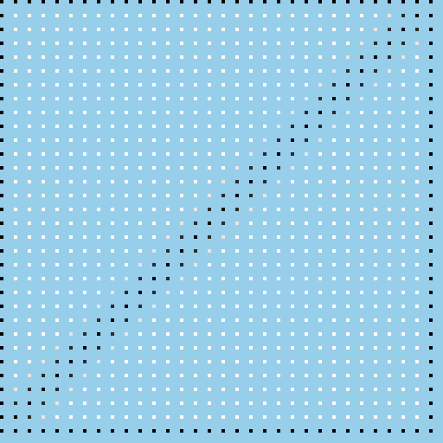
Enlarging an Image
…
…
…
…
…
…
Detail showing every 4th pixel in every 4th row with the original pixel values.
40
Notes:
40

Slide 41

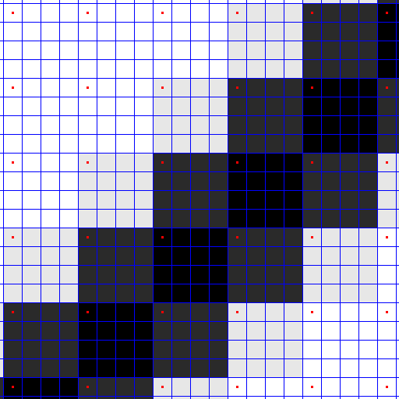
Enlarging an Image
Replicate the values
41
Notes:
41

Slide 42


Reducing an Image
Pixel Decimation
Decimation by a factor of n: take every nth pixel in every nth row
Example:
decimate this image 4x to get this image.
42
Notes:
42

Slide 43

Reducing an Image
Example:
decimate this image 4x to get this image.
Zoom in on a section for a closer look at the process
43
Notes:
43

Slide 44
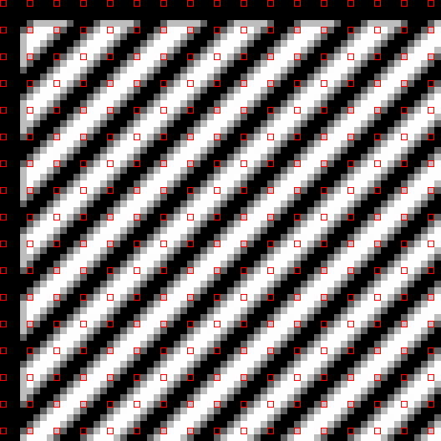
Reducing an Image
Example:
decimate this image 4x to get this image.
Keep every 4th pixel in every 4th row
44
Notes:
44

Slide 45

Reducing an Image
Example:
decimate this image 4x to get this image.
ignore all the others
45
Notes:
45

Slide 46
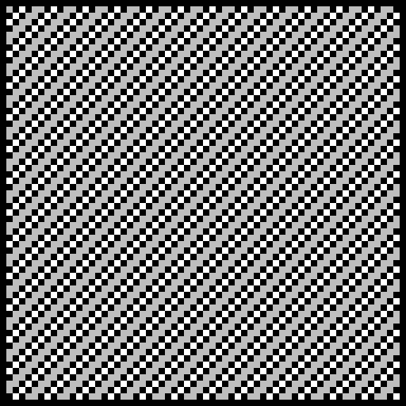
Reducing an Image
Copy them into a new image.
Example:
decimate this image 4x to get this image.
46
Notes:
46

Slide 47
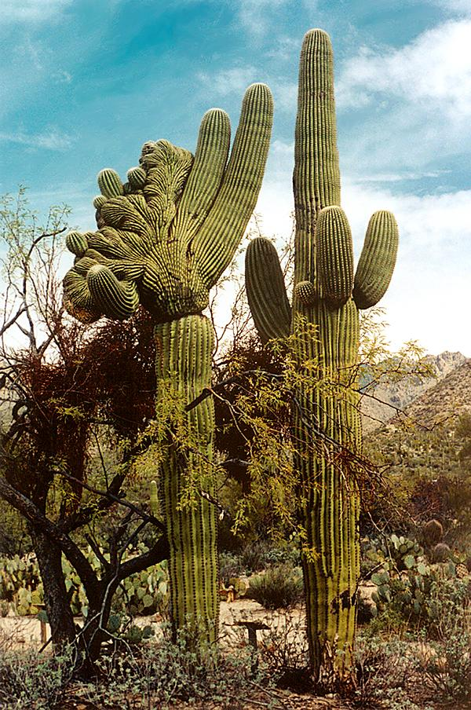
Nearest Neighbor Interpolation
The “Nearest Neighbor” algorithm is a generalization of pixel replication and decimation.
It also includes fractional resizing, i.e. resizing an image so that it has p/q of the pixels per row and p/q of the rows in the original. (p and q are both integers.)
47
Notes:
47

Slide 48


Nearest Neighbor Interpolation
Zoom in on a section for a closer look at the process
Example: resize to 3/7 of the original
48
Notes:
48

Slide 49
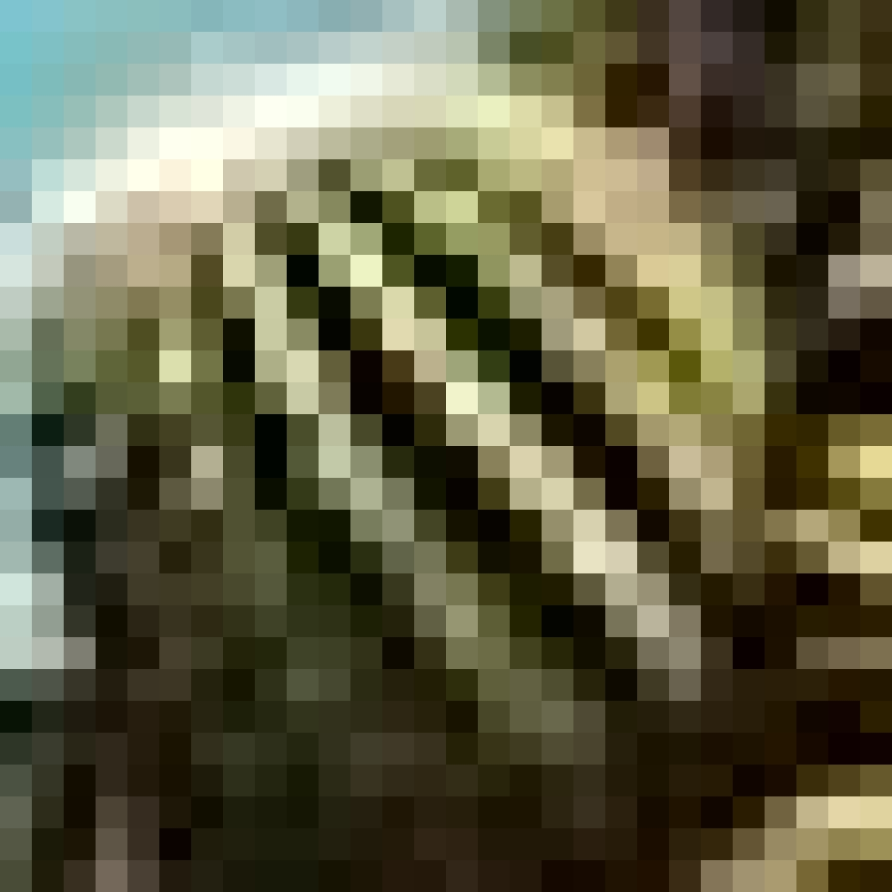
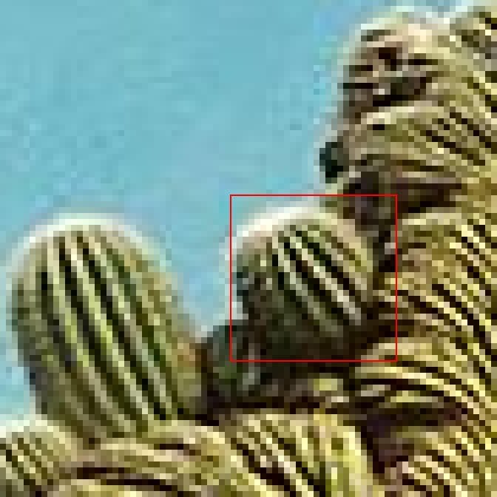
Nearest Neighbor Interpolation
3/7 resize
Zoom in for a better look
49
Notes:
49

Slide 50
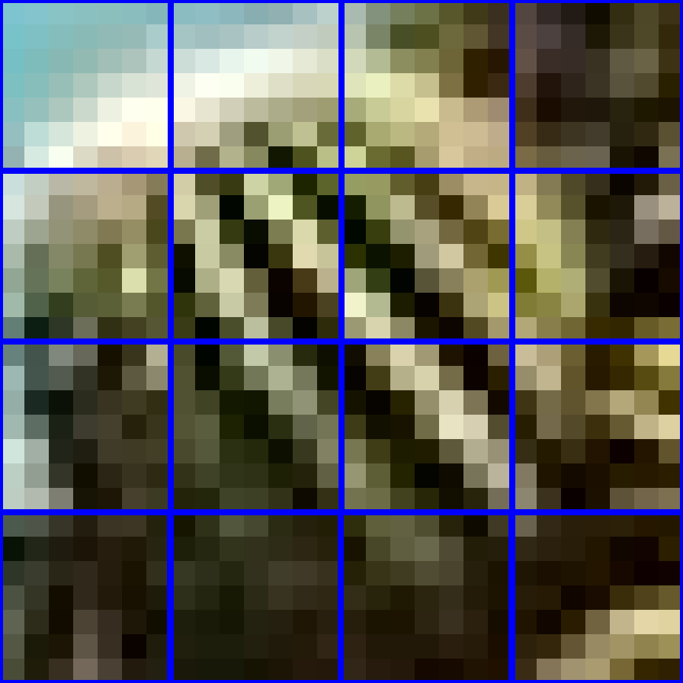
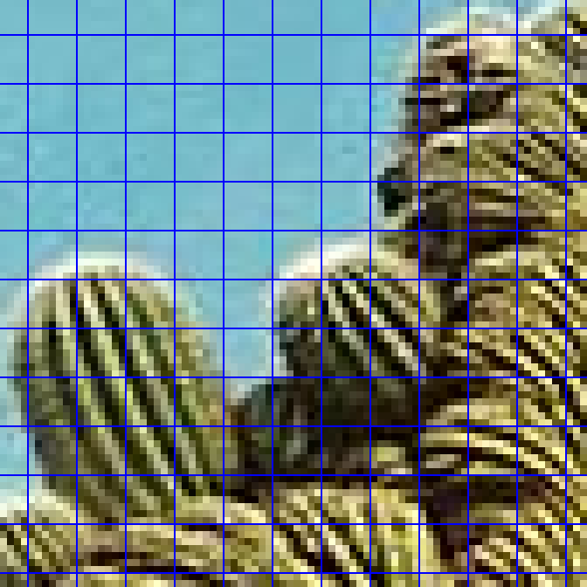
Nearest Neighbor Interpolation
3/7 resize
Outlined in blue: 7x7 pixel squares
50
Notes:
50

Slide 51
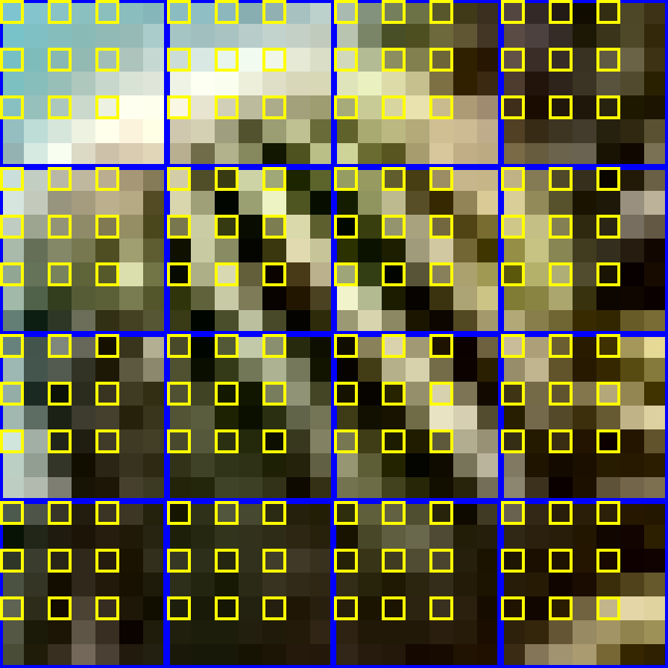
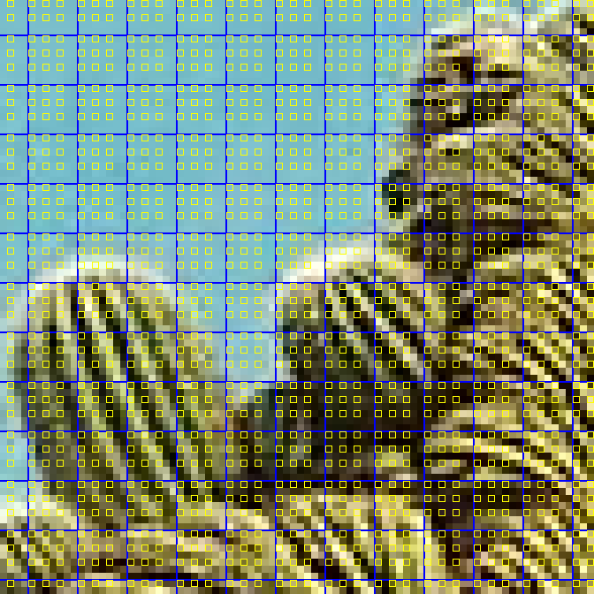
Nearest Neighbor Interpolation
3/7 resize
In yellow: 3 pixels for every 7 rows, 3 pixels for every 7 cols.
51
Notes:
51

Slide 52
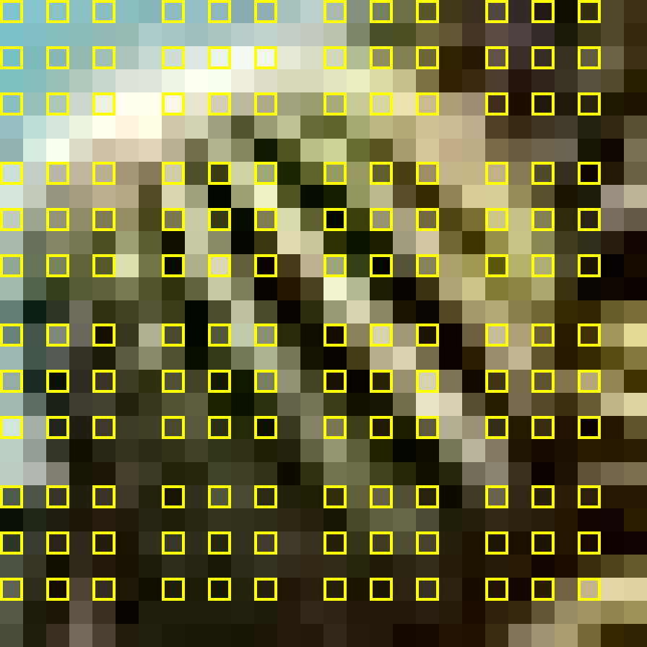

Nearest Neighbor Interpolation
3/7 resize
Keep the highlighted pixels…
52
Notes:
52

Slide 53

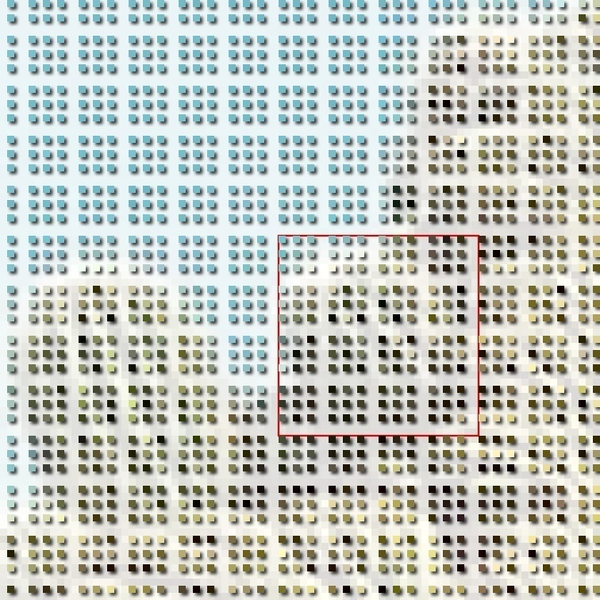
Nearest Neighbor Interpolation
3/7 resize
… don’t keep the others.
53
Notes:
53

Slide 54
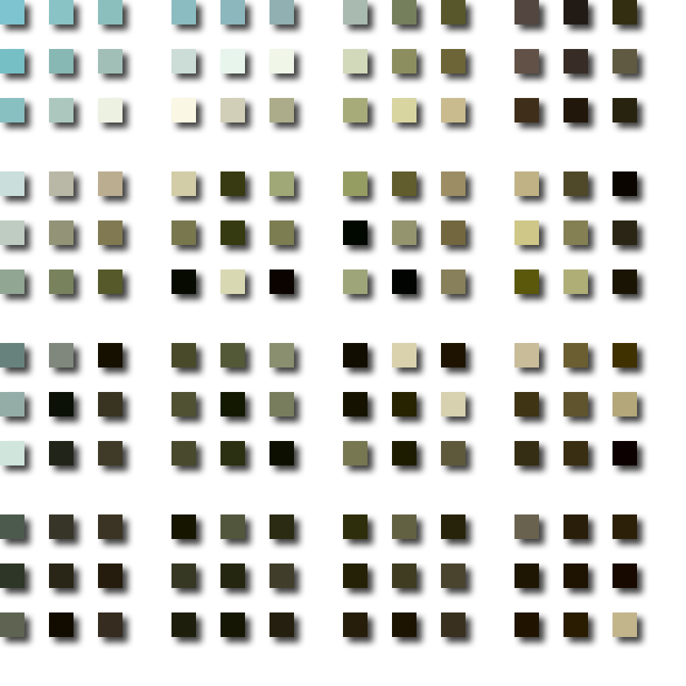
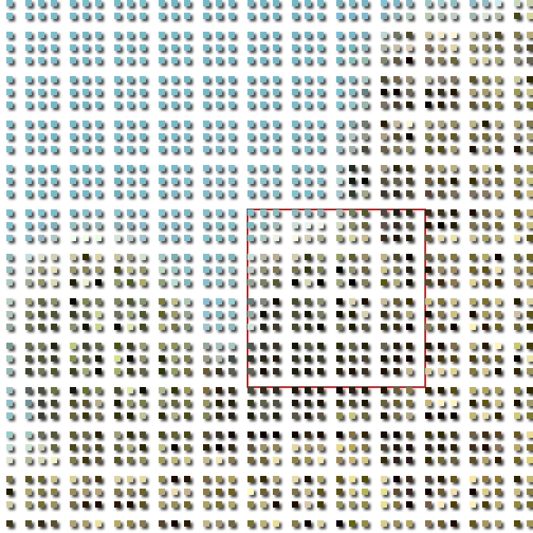
Nearest Neighbor Interpolation
3/7 resize
Copy them into a new image.
54
Notes:
54

Slide 55
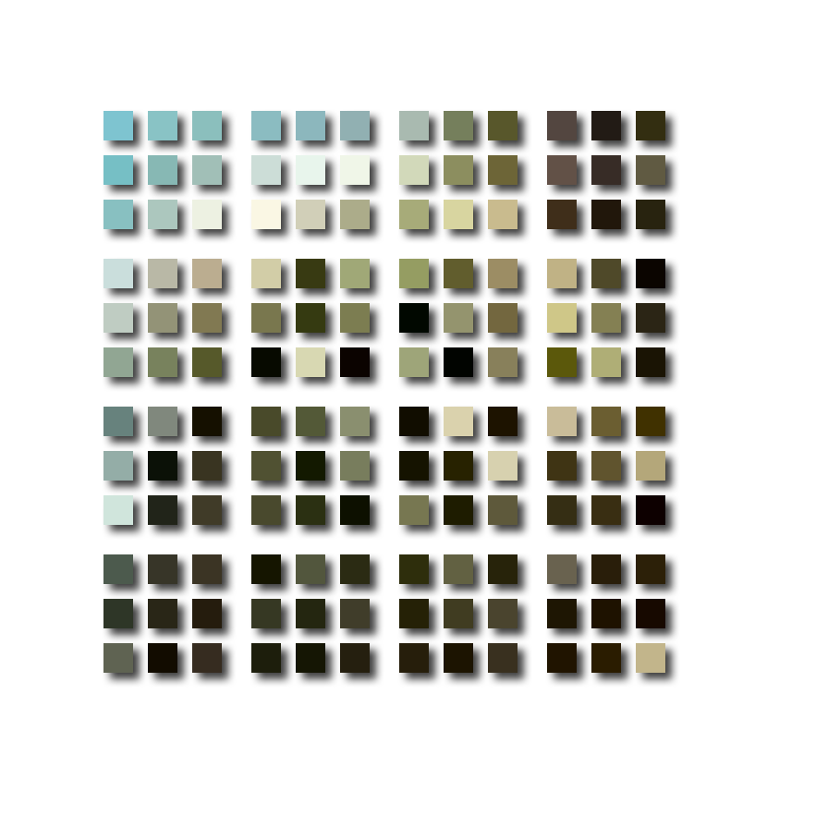

Nearest Neighbor Interpolation
3/7 resize
Copy them into a new image.
55
Notes:
55

Slide 56
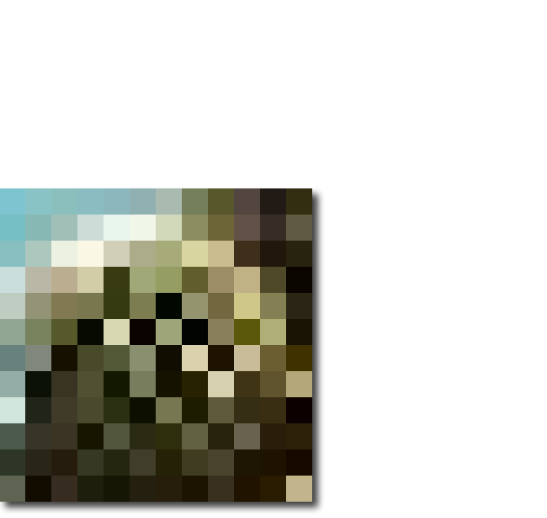
Nearest Neighbor Interpolation
3/7 times the linear dimensions of the original
56
Notes:
56

Slide 57
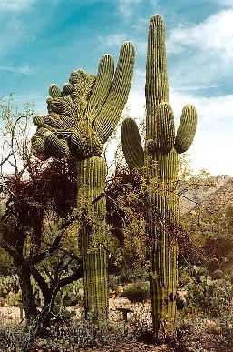
Nearest Neighbor Interpolation
Original image
Detail of resized image
Resize to 3/7 of the original dims.
57
Notes:
57

Slide 58


Nearest Neighbor Interpolation
7/3 resize
Original image
Pixels spread out for a 7/3 resize …
… then filled in.
58
Notes:
58

Slide 59
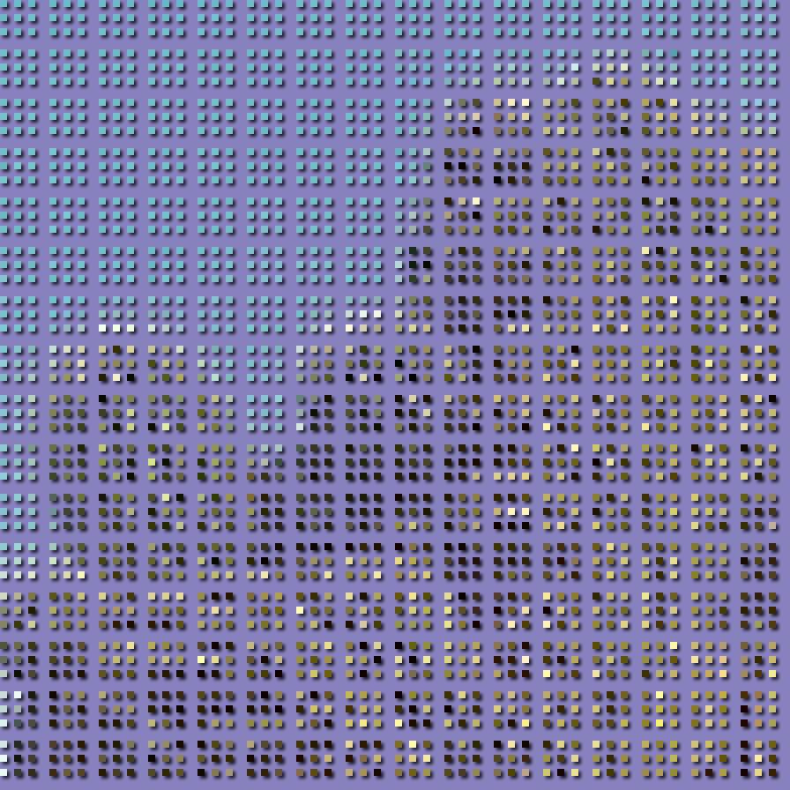

Nearest Neighbor Interpolation
7/3 resize
Each 3x3 block of pixels from here …
… is spread out over a 7x7 block here
Original image
Detail
59
Notes:
59

Slide 60
Nearest Neighbor Interpolation
7/3 resize
3x3 blocks distributed over 7x7 blocks
60
Notes:
60

Slide 61
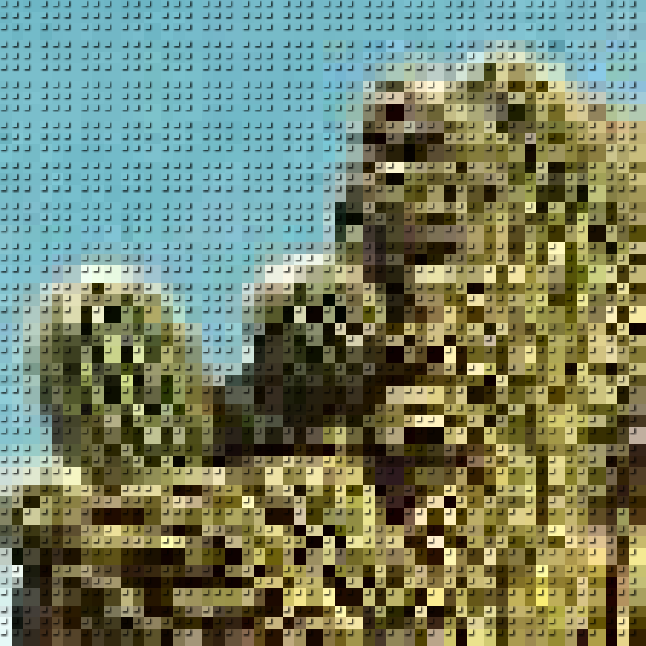
Nearest Neighbor Interpolation
7/3 resize
Empty pixels filled with color from non-empty pixel
61
Notes:
61

Slide 62
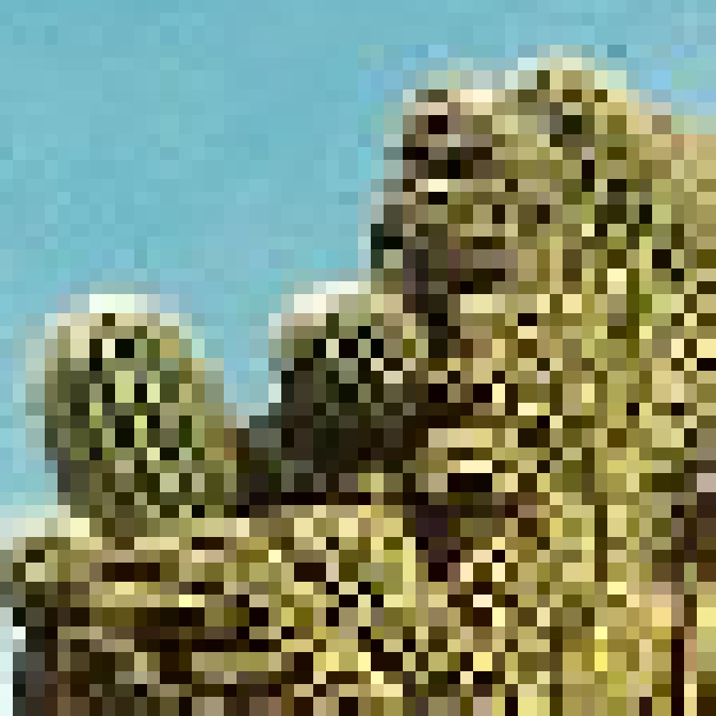
Nearest Neighbor Interpolation
7/3 resize
Empty pixels filled with color from non-empty pixel
62
Notes:
62

Slide 63
Nearest Neighbor Interpolation
Original image
7/3 resized

Slide 64
Image Interpolation
Nearest neighbour interpolation
Simple but produces undesired artefacts
Bilinear Interpolation
Contribution from 4 neighbors
Bicubic Interpolation
Contribution from 16 neighbors
64
Notes:
64

Slide 65
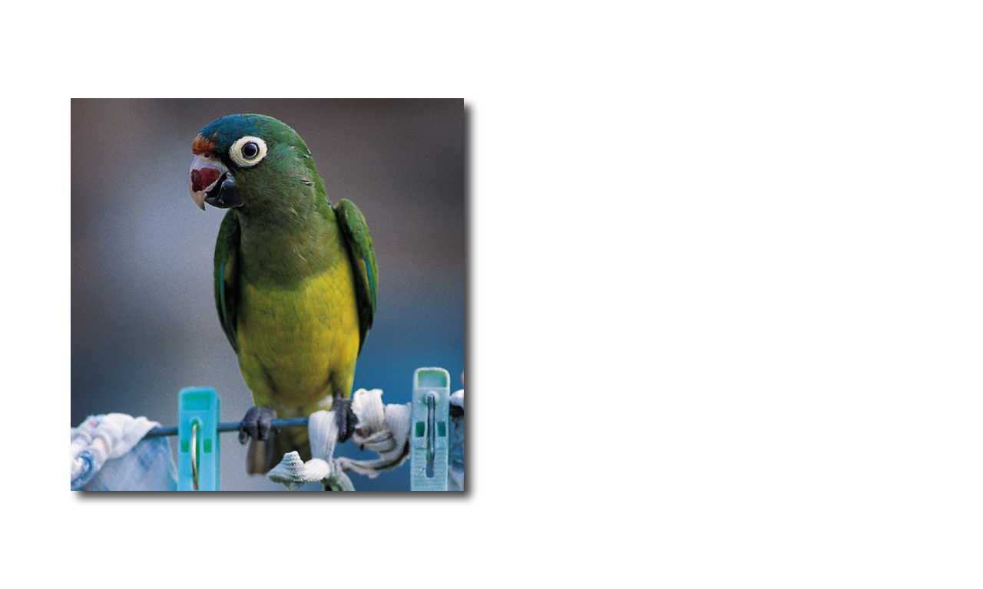
Interpolation: Comparison
We’ll enlarge this image by a factor of 4 …
… via bilinear interpolation and compare it to a nearest neighbor enlargement.

Slide 66
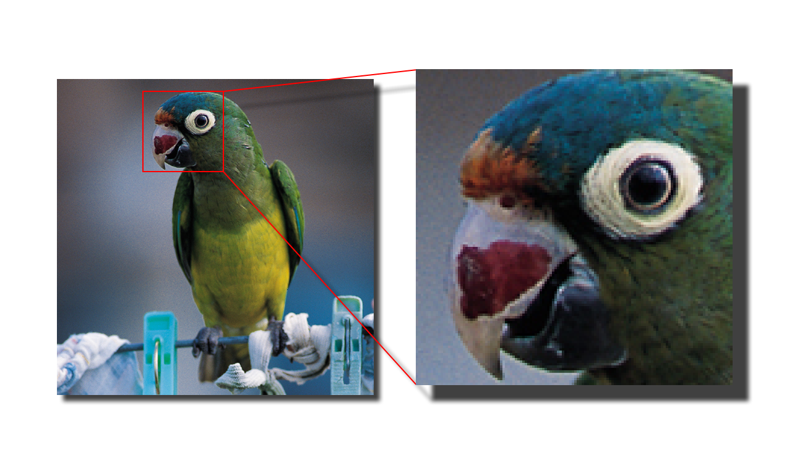
Interpolation: Comparison
Original Image
To better see what happens, we’ll look at the parrot’s eye.

Slide 67

Interpolation: Comparison
Pixel replication
Bilinear interpolation

Slide 68

Interpolation: Comparison
Pixel replication
Bilinear interpolation

Slide 69
Steganography
The science of writing hidden messages in such a way that no one, apart from the sender and intended recipient, suspects the existence of the message
69
Notes:
69

Slide 70



Steganography
Before Moving On ….
Recall – Logical Shift Operators
Logical left shift one bit
Logical right shift one bit
70
Notes:
70

Slide 71




Steganography
Two least significant bits are 0
8-bit Image
6-bit Image
If an image is quantized, say from 8 bits to 6 bits and redisplayed it can be all but impossible to tell the difference between the two.

Slide 72
Steganography
If the 6-bit version is displayed as an 8-bit image then the 8-bit pixels all have zeros in the lower 2 bits:
That other information could be a message, perhaps encrypted, or even another image.
Image 1
Image 2
b
b
b
b
b
b
0
0
R-Shift 2
R-Shift 6
b = 0 or 1
always 0
L-Shift 2
This introduces the possibility of encoding other information in the low-order bits.
logical OR
Image Out
X-Shift n = logical left or right shift by n bits.
72
Notes:
72

Slide 73


Steganography
182
1 | 0 | 1 | 1 | 0 | 1 | 1 | 0
220
R-Shift 2
1 | 1 | 0 | 1 | 1 | 1 | 0 | 0
0 | 0 | 1 | 0 | 1 | 1 | 0 | 1
R-Shift 6
180
L-Shift 2
03
0 | 0 | 0 | 0 | 0 | 0 | 1 | 1
1 | 0 | 1 | 1 | 0 | 1 | 0 | 0
183
1 | 0 | 1 | 1 | 0 | 1 | 1 | 1

Slide 74

Steganography
183
1 | 0 | 1 | 1 | 0 | 1 | 1 | 1
L-Shift 6
192
1 | 1 | 0 | 0 | 0 | 0 | 0 | 0
How to get the second image
Extracted Second Image

Slide 75

Steganography
If we have only 4 colors (2-bits) and we put them in the lower order bits
182
1 | 0 | 1 | 1 | 0 | 1 | 1 | 0
03
R-Shift 2
0 | 0 | 0 | 0 | 0 | 0 | 1 | 1
0 | 0 | 1 | 0 | 1 | 1 | 0 | 1
R-Shift 6
180
L-Shift 2
03
0 | 0 | 0 | 0 | 0 | 0 | 1 | 1
1 | 0 | 1 | 1 | 0 | 1 | 0 | 0
No need to shift right
183
What would you do to get back original data?
1 | 0 | 1 | 1 | 0 | 1 | 1 | 1

Slide 76

Steganography
8-bit-per-band, 3-band, “original” image
76
Notes:
76

Slide 77

Steganography
6-bit-per-band, 3-band, quantized image
77
Notes:
77

Slide 78


Steganography
green-band histogram of 8-bit image
green-band histogram of 6-bit image
The histograms of the two versions indicate which is which. If the 6-bit version is displayed as an 8-bit image it has only pixels with values 0, 4, 8, … , 252.
78
Notes:
78

Slide 79
Steganography
The second image is invisible because the value of each pixel is between 0 and 3. For any given pixel, its value is added to the to the collocated pixel in the first image that has a value from the set {0, 4, 8, … , 252}. The 2nd image is noise on the 1st.
79
Notes:
79

Slide 80
Steganography
L-Shift 6
?
To recover the second image (which is 2 bits per pixel per band) simply left shift the combined image by 6 bits.
80
Notes:
80

Slide 81

Steganography
L-Shift 6
image
To recover the second image (which is 2 bits per pixel per band) simply left shift the combined image by 6 bits.
81
Notes:
81

Slide 82
Steganography
Images 1 and 2 each have 4-bits per pixel when combined.
This is so effective that two 4-bit-per-pixel images can be superimposed with only the image in the high-order bits visible. Both images contain the same amount of information but the image in the low-order bits is effectively invisible
Image 1
Image 2
R-Shift 4
R-Shift 4
L-Shift 4
Image Out
82
Notes:
82

Slide 83

Steganography
Original Image
83
Notes:
83

Slide 84

Steganography
Image quantized to 4-bits per pixel.
84
Notes:
84

Slide 85

Steganography
Image 1 in upper 4-bits. Image 2 in lower 4-bits.
85
Notes:
85

Slide 86

Steganography
Extracted Image
86
Notes:
86

Slide 87

Steganography
http://mozaiq.org/encrypt/
87
Notes:
87

Slide 88
Relationships between pixels
Neighbors of pixel are the pixels that are adjacent pixels of an identified pixel
x-1
x
x+1
y-1
y
y+1
88
Notes:
88

Slide 89
4- Neighbors of a Pixel –N₄(p)
x-1
x
x+1
y-1
What are the coordinates of each of the blue pixels
y
y+1
(x-1,y), (x+1,y), (x, y-1), (x, y+1)
89
Notes:
89

Slide 90
Diagonal Neighbors of a Pixel –N_{D}(p)
x-1
x
x+1
y-1
y
y+1
(x-1,y-1), (x+1,y-1), (x-1, y+1), (x+1, y+1)
90
Notes:
90

Slide 91
8- Neighbors of a Pixel –N₈(p)
x-1
x
x+1
y-1
y
y-1
(x-1,y), (x+1,y), (x, y-1), (x, y+1)
(x-1,y-1), (x+1,y-1), (x-1, y+1), (x+1, y+1)
91
Notes:
91

Slide 92
Determine different regions in the image
92
Notes:
92

Slide 93
Connectivity
Establishing boundaries of objects and components in an image
Group the same region by assumption that the pixels being the same color or equal intensity
Two pixels p & q are connected if
They are adjacent in some sense
If their gray levels satisfy a specified criterion of similarity
93
Notes:
93

Slide 94
Connectivity
V: Set of gray levels used to define the criterion of similarity
4-connectivity
If gray level
Set of gray levels V = {1}
94
Notes:
94

Slide 95

Connectivity
V: Set of gray levels used to define the criterion of similarity
8-connectivity
If gray level
Set of gray levels V = {1}
95
Notes:
95

Slide 96
Connectivity
V: Set of gray levels used to define the criterion of similarity
m-connectivity (Mixed Connectivity)
If gray level
a.
b.
96
Notes:
96

Slide 97
Example: m – Connectivity
Set of gray levels V = {1}
Note: Mixed connectivity can eliminate the multiple path connections that often occurs in 8-connectivity
97
Notes:
97

Slide 98
Paths
Path: Let coordinates of pixel p: (x, y), and of pixel q: (s, t)
A path from p to q is a sequence of distinct pixels with coordinates: (x₀, y₀), (x₁, y₁), ......, (x_{n},y_{n})
where (x₀, y₀) = (x, y) & (x_{n},y_{n}) = (s, t), and (x_{i},y_{i}) is adjacent to (x_{i-1},y_{i-1}) 1≤i ≤n
98
Notes:
98

Slide 99

CC labeling – 4 Connectivity
Process the image from left to right, top to bottom:
1.) If the next pixel to process is 1
i.) If only one of its neighbors (top or left) is 1, copy its label.
ii.) If both are 1 and have the same label, copy it.
iii.) If they have different labels
− Copy the label from the left.
− Update the equivalence table.
iv.) Otherwise, assign a new label.
Re-label with the smallest of equivalent labels
Pass 1
Pass 2
99
Notes:
99

Slide 100


CC labeling – 4 Connectivity
100
Notes:
100

Slide 101

CC labeling – 4 Connectivity
101
Notes:
101

Slide 102
CC labeling – 8 Connectivity
Same algorithm but examine also the upper diagonal neighbors of p
102
Notes:
102

Slide 103
CC labeling – 8 Connectivity
Background pixel
Background pixel
Unlabeled Pixel
Unlabeled Pixel
Label 1
103
Notes:
103

Slide 104
CC labeling – 8 Connectivity
Background pixel
Background pixel
Unlabeled Pixel
Unlabeled Pixel
Label 1
Label 1
Label 2
Label 2
Label 3
104
Notes:
104

Slide 105

CC labeling – 8 Connectivity
Background pixel
Background pixel
Unlabeled Pixel
Unlabeled Pixel
Label 1
Label 1
Label 2
Label 2
Label 3
Label 3
105
Notes:
105

Slide 106


CC labeling – 8 Connectivity
Background pixel
Background pixel
Unlabeled pixel
Unlabeled pixel
Label 1
Label 1
Label 2
Label 2
Label 3
Label 3
106
Notes:
106

Slide 107
CC labeling – 8 Connectivity
Background pixel
Background pixel
Unlabeled pixel
Unlabeled pixel
Label 1
Label 1
Label 2
Label 2
Label 3
Label 3
Label 4
Label 4
107
Notes:
107

Slide 108
Distance Metrics
Let pixels p, q and z have coordinates (x,y), (s,t) and (u,v) respectively.
D is a distance function or metric if
D(p,q) ≥ 0 and
D(p,q) = 0 iff p = q and
D(p,q) = D(q,p) and
D(p,z) ≤ D(p,q) + D(q,z)
108
Notes:
108

Slide 109
City block distance (D₄ distance)
Diamond with center at (x,y)
D₄ = 1 are the 4 neighbors of pixel p(x,y)
109
Notes:
109

Slide 110
Chessboard distance (D₈ distance)
Square centered at p(x,y)
D₈ = 1 are the 8 neighbors of pixel p(x,y)
110
Notes:
110

Slide 111
Euclidean Distance
A circle with radius r centered at (x,y)
q(s,t)
r
p(x,y)
111
Notes:
111

Slide 112
Arithmetic Operations
Carried out between corresponding pixel pairs
112
Notes:
112

Slide 113
Arithmetic Operations
Conversion to range 0 – 255
Difference of two 8-bit images: -255 to 255
Sum of two 8-bit images: 0 to 510
Solution?
Set all values < 0 to 0
Set all values > 255 to 255
Full range of arithmetic operation not captured
113
Notes:
113

Slide 114
Arithmetic Operations
First perform the operation
Then perform
Creates an image whose minimum value is 0
Creates a scaled image f_{s} with values in the range [0 K]
114
Notes:
114

Slide 115

Logical Operations (Binary Images)
115
Notes:
115

Slide 116

Reading Assignment
2.6.1 Array versus Matrix Operations
2.6.2 Linear versus Non-Linear Operations

Slide 117
Readings from Book (3rd Edn.)
2.4 Image Sampling & Quantization*
2.5 Basic Relationships between Pixels
*Discussion related to figures 2.22 and 2.23 has not been covered

Slide 118
Acknowledgements
Digital Image Processing”, Rafael C. Gonzalez & Richard E. Woods, Addison-Wesley, 2002
Peters, Richard Alan, II, Lectures on Image Processing, Vanderbilt University, Nashville, TN, April 2008
Brian Mac Namee, Digitial Image Processing, School of Computing, Dublin Institute of Technology
Computer Vision for Computer Graphics, Mark Borg
Material in these slides has been taken from the following resources
118
Notes:
118

